Slide 1
Baltic Navigational Warning service

Slide 2
Baltic Navigational Warning Service
The purpose with the Baltic Navigational Warning Service is to provide the service consumer, i.e. ship, with only those safety notices (MSI and T&P notices) that are relevant for their specific route.
The safety notices will be displayed directly in ECDIS and automatically deleted when they are expired and no longer valid.
T&P notices are excluded from S-124, but it is of great value to be able to test to send all temporal information in one service.

Slide 3
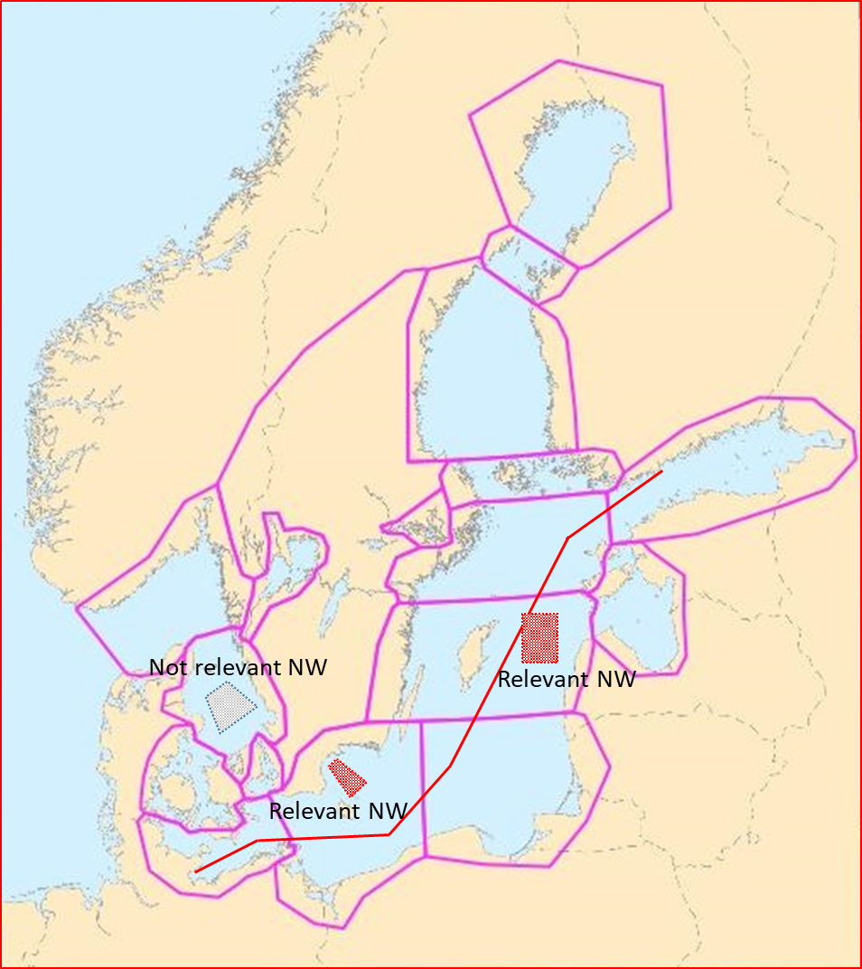
Baltic Navigational Warning Service
When a ship shares a voyage plan with the service, all active safety notices within 15 nautical miles on each side of the route centerline is returned to ship. (This is the same MSI information that is currently broadcasted on NAVTEX and VHF. T&P notices are those that are currently in force)
During the voyage the ship also receives new safety notices until the voyage is completed/leaves the area
When safety notices expire, they will automatically be deleted

Slide 4
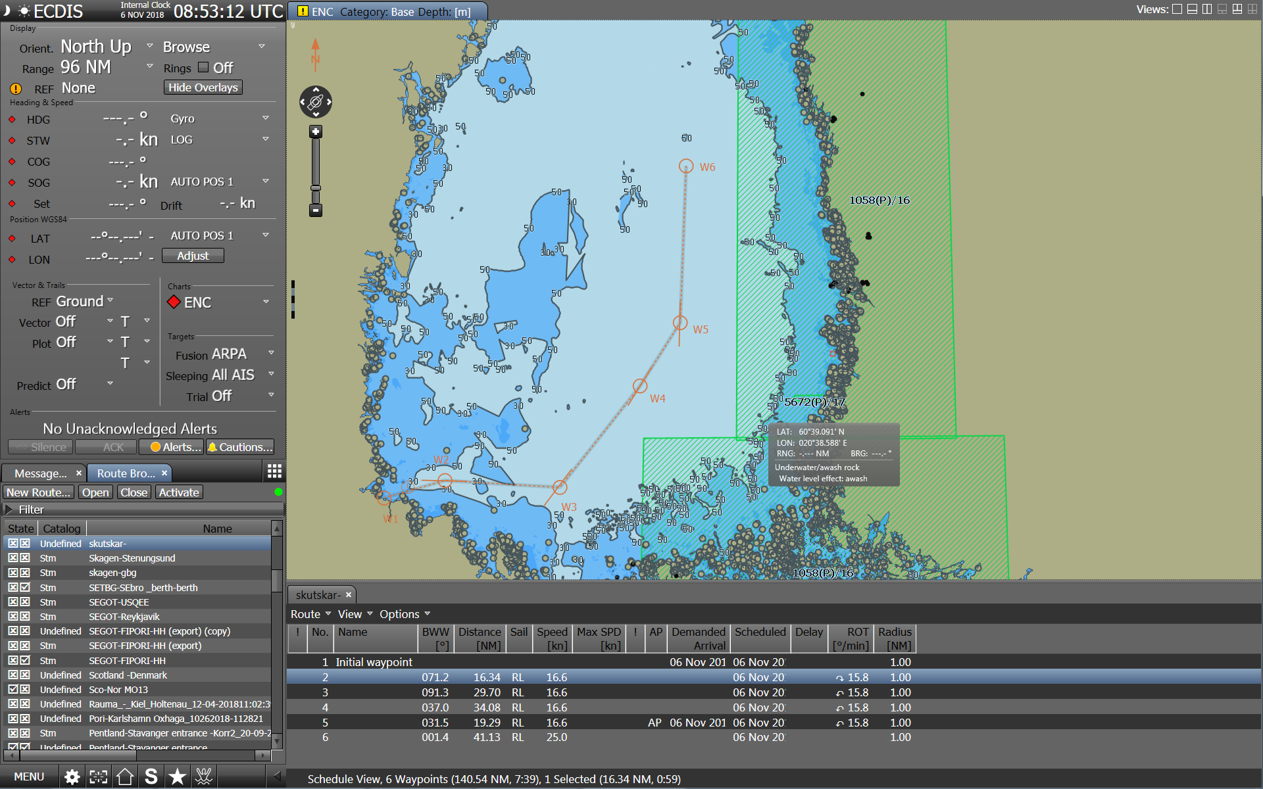
Share voyage plan with BNWS (all active safety notices within 15 nm corridor will be received)
Notes:
Att dela en resa

Slide 5
Service benefits
Reduced workload – No need to manually plot positions/areas
Increased safety of navigation –By providing safety notices directly to the ECDIS the risk of missing important information is reduced.
Reduced human errors –Human errors in misunderstandings and manual plotting is avoided
Increased focus – Only relevant safety notices are displayed

